Slide 1
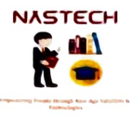
Cartoonify Image using python
RNS INSTITUTE OF TECHNOLOGY
BENGALURU - 98
DEPARTMENT OF INFORMATION SCIENCE & ENGINEERING
Presentation on Internship
Ameena Taj Qureshi
USN: 1RN1365IS1
New Age Solutions Technologies
Internal Guide
Dr. Bhagyashree Ambore
Prof./Asso. Prof./Asst. Prof, Dept of ISE, RNSIT
External Guide
Mr. Aman upadhyay
NASTECH

Slide 2
AGENDA
Abstract
About the Company
Introduction
Literature Survey
Requirements
System Design
Detailed Design
Implementation
Testing
Conclusion and Future Enhancements
References
Q & A

Slide 3
ABSTRACT
Intership Project Domain: CARTOONNIFY IMAGE USING PYTHON,
Anaconda Framework for Python IDE & Packages (Recommended), Jupyter notebook, Tensorflow machine Learning library
Cartoonify Image represents different techniques of converting image to cartoon.
It is possible to convert all types of captured images to cartoon such as images of person, mountains, trees, flora and fauna etc.
There are several other techniques for image to cartoon conversion such as using photoshop, adobe illustrator, windows MAC, paint.

Slide 4
About the Company
Since the foundation in 1987, Nastech has focused on the localization of steel through continuous technology development and research activities.
Our high-carbon steel and heat treatment products are widely used in a various range of industries, including automotive parts, household electronics, machineries and tools, also contribution to the development of national industries and the improvement of the people's welfare.
All Nastech family is focused on the quality innovation and the technology development with pride and dignity as steel workers who are the foundation of the industry. We will do our best to create high-tech and quality products that meet your expectations. Through continuous facility investment and stable management,
Nastech is the most competitive cold-rolled and heat-treated steel company that the domestic and international customers want to have business first.

Slide 5
INTRODUCTION
As you might know, sketching or creating a cartoon doesn’t always need to be done manually.
Nowadays, many apps can turn your photos into cartoons. I will tell you, that you can create your own effect with few lines of code?
There is a library called OpenCV which provides a common infrastructure for computer vision applications and has optimized-machine-learning algorithms.
It can be used to recognize objects, detect, and produce high-resolution images.
In this tutorial, I will show you how to give a cartoon-effect to an image in Python by utilizing OpenCV.
I used Pycharm to write and run the code. You can access the full code using python

Slide 6
LITERATURE SURVEY
Give the survey
Year of The Paper | Title of the Paper | Methodology Used | Advantage | Limitation
2015 | A Neural Algorithm of Artistic Style (Leon A. Gatys, Alexander S. Ecker, Matthias Bethge) | An artificial system based on a Deep Neural Network that creates artistic images of high perceptual quality. we take pre-trained neural network and define a 3 Component loss function that will enable us to achieve our end goal of style transfer and then optimize over that loss function | First Ever Successful Attempt to create Artistic style transfer using Deep Neural Network. All previous attempts/algorithms to achieve style transfer had failed. The system uses neural representations to separate and recombine content and style of arbitrary images, providing a neural algorithm for the creation of artistic images. | While the Gatys et al. method produced beautiful neural style transfer results, the problem was that it was quite slow.

Slide 7
Requirements
REQUIREMENT SPECIFICATION
HARDWARE REQUIREMNETS
Windows 10, 64 bits PC or 64 Bit Mac OS X High Sierra computers Any CPU (Intel i5/ i7/ Xeon recommended). Nvidia GPUs
(minimum 2GB Recommended) At least 8 GB RAM, 10 GB HDD
Free Space.
SOFTWARE REQUIREMNETS
Anaconda Framework for Python IDE & Packages (Recommended), Jupyter notebook, Tensorflow machine Learning library
Programming Language: Python

Slide 8
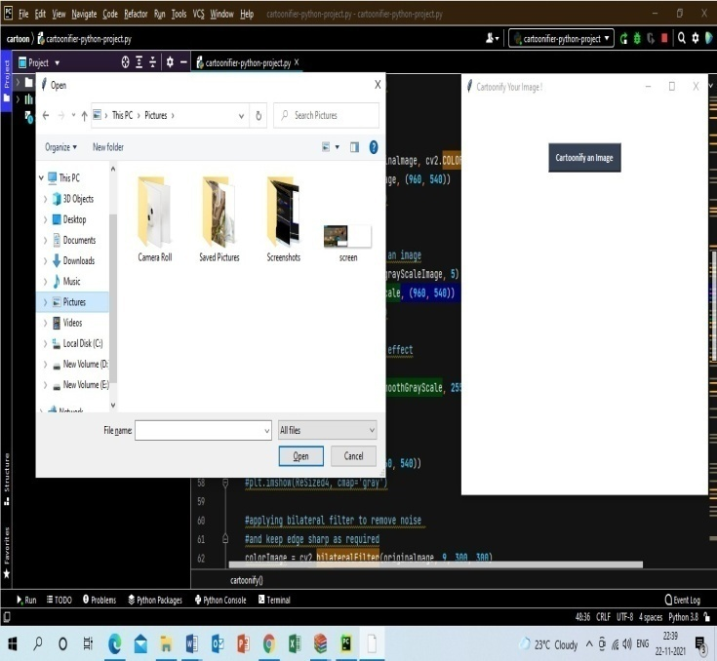
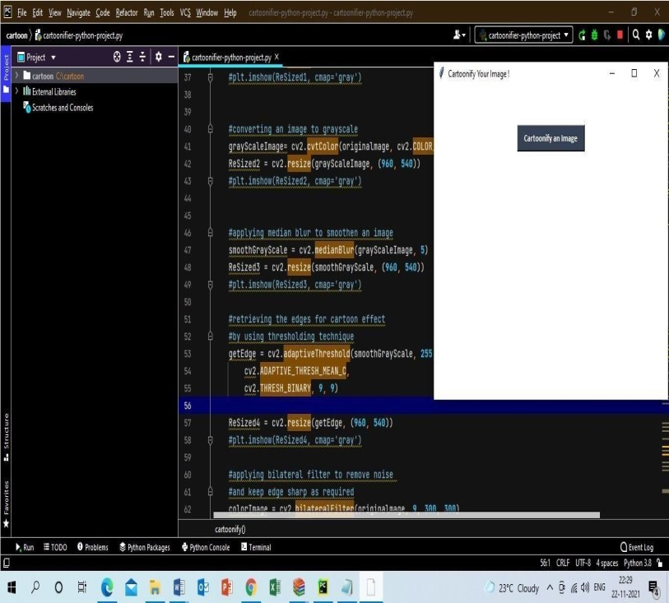
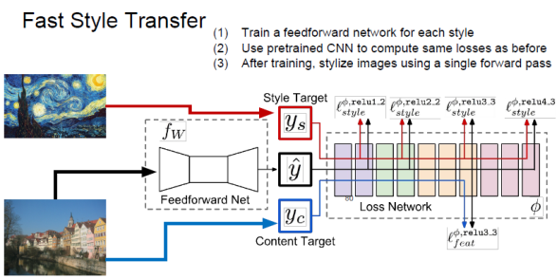
System Design
Diagrams
Process Diagram Home page Selecting

Slide 9
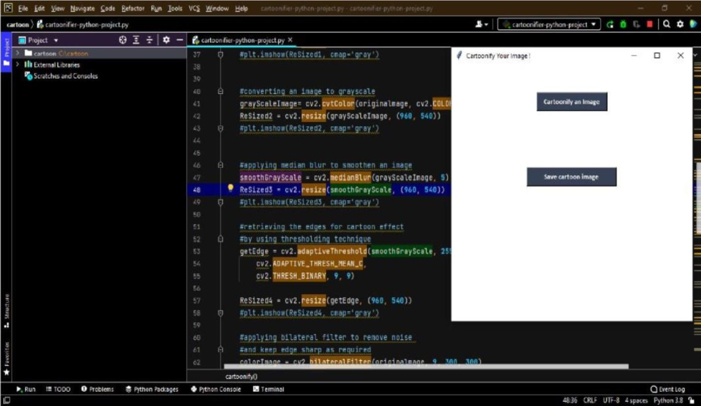
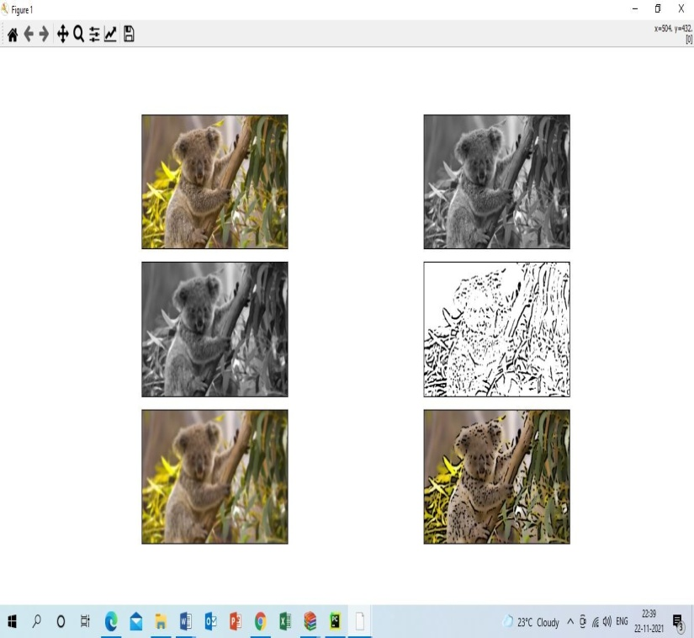
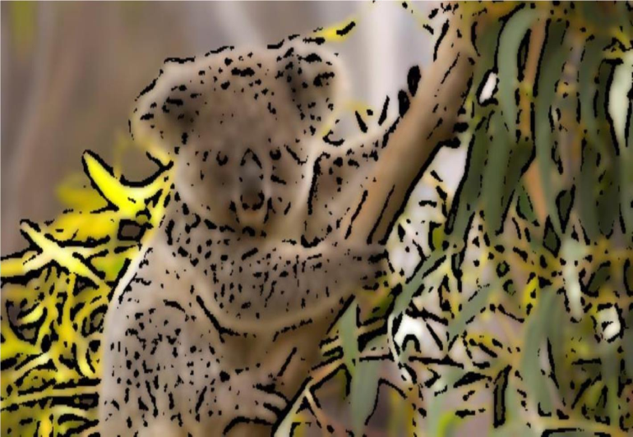
Detailed Design
Design details – diagrams / …
Saving Image Cartoonified Image
Saved Cartoonified Image
^0 '

Slide 10
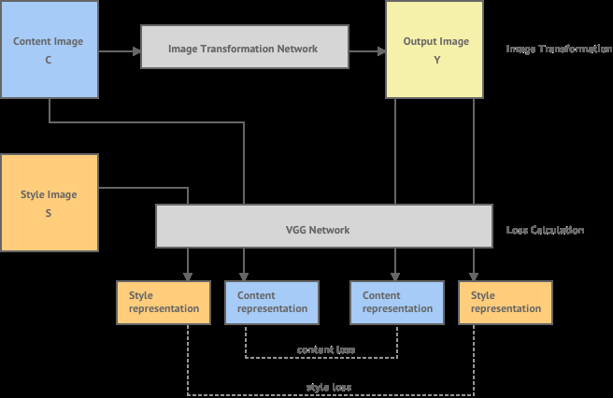

Implementation / Coding
Write algorithms / pseudocode / flow chart
The algorithm can be implemented in Python/JavaScript/Lua to perform neural style transfer.
We will use Python to implement the backend and the front end of the website will be in HTML, CSS & JS.
Basically, in Neural Style Transfer we have two images- style and content.
We need to copy the style from the style image and apply it to the content image.
By, style we basically mean, the patterns, the brushstrokes, etc. we will provide a set of style images which a user can use to apply different kinds of Cartoon like effects to his image. Our implementation uses TensorFlow to train a fast style transfer network. We use roughly the same transformation network as described in Justin Johnson et. al, except that batch normalization is replaced with Ulyanov's instance normalization. We use a loss function close to the one described in Gatys, using VGG19 instead of VGG16 and typically using "shallower" layers than in Johnson's implementation (e.g. we use relu1_1 rather than relu1_2). Empirically, this results in larger scale style features in transformations

Slide 11
Design Details
Install PyCharm, which is one of many IDEs available for python. PyCharm is an integrated development used in computing programming, specifically for the python language. Coding assistance and analysis, with code completion, syntax and error highlighting, linter integration, and quick fixes. Project and code navigation specialized project views, file structure view and quick jumping between file, classes, methods and usages. It is cross platform provides code analysis, graphical debugger, an integrated unit tester integration with version control systems.
Step 1: Creating a python project
Open PyCharm and select Create New Project.
Select the location and a name for your project (medium tutorial in this case)
Expand the Project Interpreter option and select Existing interpreter
Locate your environment by clicking on the three dots on the extreme
Step 2: Typing the source code
The source code of the desired with all required package is installed. Which involves various module
like numpy, pandas, matplotlib etc.
Step 3: Import the csv file
Click Start Turning Photos into Cartoons button to enter the cartoon photo editing webpage and then click Choose Photo button to choose the photo from your computer. After uploading the photo, you start to outline the region you need to turn into cartoon. Stop outlining by clicking the right mouse button. Click Render to start cartoonize your photo.
Step 4: Running the Application
Step5:Run/Debug Configuration

Slide 12
CONCLUSIONS
Thus we have shown that how image can be converted to cartoon. We also stated the examples on how image is converted to cartoon. Hardware and software requirements of image to cartoon conversion are also shown in this paper. The systematic working of image to cartoon conversion and respective algorithm and formulae is shown with neat diagram in this paper. Also we have stated challenges and problems one can face while cartoonifying the captured image. In this paper we have also discussed need and scope of cartoonifying the content image

Slide 13
Future Enhancements
CHALLENGES AND PROBLEM
Training of networks for different style images is time consuming and requires lots of computation hardware(GPUs).
Different content images may produce slightly different styled images.
Precision of cartoon like effect entirely depends on type of content image provided.
Convert photo to cartoon with Paint.net Paint.
net is a fee photo editor for Windows, depending on the .Net framework.
As one of the best alternatives for Microsoft Paints, Paint.net offers more effects and features, including make cartoon photos with personal images.

Slide 14
REFERENCES
[1]. A Neural Algorithm of Artistic Style, 2016 - Leon A. Gatys, Alexander S. Ecker, Matthias Bethge
[2]. Image Style Transfer Using Convolutional Neural Networks, 2016 - Leon A. Gatys, Alexander S. Ecker, Matthias Bethge
[3]. Perceptual Losses for Real-Time Style Transfer and Super-Resolution, 2016 - Justin Johnson, Alexandre Alahi, Li Fei-Fei
[4]. Precomputed Real-Time Texture Synthesis with Markovian Generative Adversarial Networks, 2016 - Chuan Li, Michael Wand
[5]. Texture networks: Feed-forward synthesis of textures and stylized images, 2016 - D. Ulyanov, V. Lebedev, A. Vedaldi, V. Lempitsky
[6]. Demystifying Neural Style Transfer, 2017 - Yanghao Li, Naiyan Wang, Jiaying Liu, Xiaodi Hou
.
.
.
.
.

Slide 15
Question and Answer

Slide 16
THANK YOU

